Slide 1







Interfaces, Models, and Monitoring for Resource-aware Transformations that Augment the Lifecycle of Systems (IMMoRTALS)
BBN Site Visit

Slide 2
Agenda
Program Review Presentation
Demonstration
Discussion

Slide 3
Outline of the Program Review Presentation
Programmatics
Goals, Assumptions, Key Concepts
Phase 1 CPs
Discovery and Analysis Technologies
Representation
Program analysis
Resource DSL
Change tracking
DAS Development
LL Interaction
Next Steps and Conclusion

Slide 4
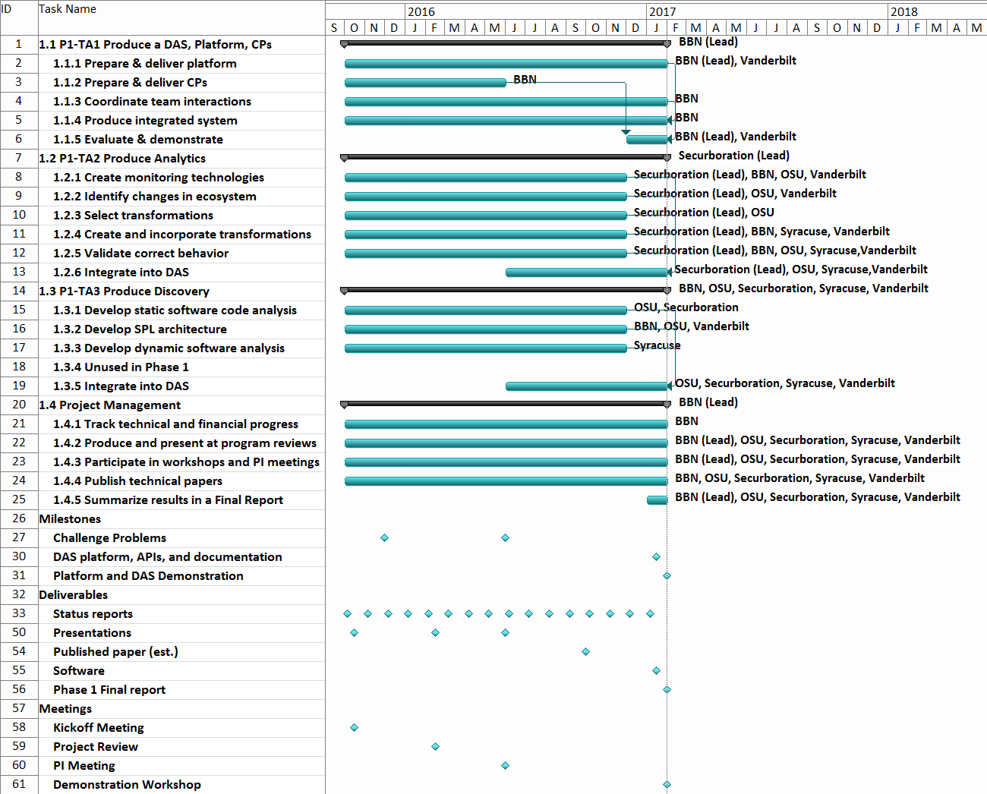
Programmatics
We are here

Slide 5
Summary of Progress (TBD)
List of what we have achieved– milestones, publications, talks/presentations etc

Slide 6
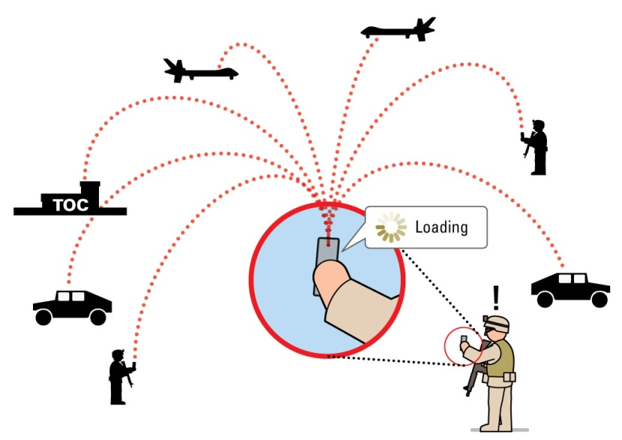
IMMoRTALS Goals
Develop, demonstrate and evaluate technology to make tactical situational awareness (information management) application evolve
Evolve (accommodate ecosystem changes) by
Substitution
Modification
Substitution requires
Existence of the substitute
Ability to identify the substitutable and a matching substitute
Modification requires
A change prescription
Ability to translate prescription into code change– guidance, template etc.
Modification produces potential substitutes
Modified function f of a class C → new class C→ new component that uses C
Our initial focus is “substitution,” where substitutes already exist

Slide 7
Assumptions (TB refined)
Software Product Line (SPL)– applications are architected as SPL
Structure of the application
Abstraction of the features/functional components
Semantics/Annotation
Functional specification of code is not derived automatically
Extra-functional specification (e.g., resource specification, dependencies) will be
Deployment environment and mission requirement description
Capabilities of a deployment environment and mission requirements are not derived automatically- they are provided manually in a form prescribed by IMMoRTALS
This is one of the current weaknesses– need to work on this next

Slide 8
Key Concepts (TBD)
DFUs
IMMoRTALS Knowledge Repository
Resource DSL

Slide 9
IMMoRTALS Solution Overview
Initial Intake
Specification
Other models
Program Analysis
Program Synthesis
Program
TA1 product
Ecosystem
TA2 product
KR artifacts
TA3 product
Runtime Management
In use during mission
code artifacts
In use off line from the mission
Deploy,
redeploy
Test & Validate
Build
Iterative refinement of SPL variant for a given specification
Monitor
Specification of a new variant
Adaptation of running application
Changes in runtime system
(resource availability, anticipated changes)
Ecosystem changes,
Mission requirement changes

Slide 10
Phase 1 CPs
CP1: External service dependency (e.g. GPS)
CP2: Mission requirement dependency (number of clients, message rate, message size)
Each CP has various progressions:
Change requested before deployment
DFUs needed to configure an alternate product exists
DFUs needed to configure the alternate does not exist
Change detected at runtime/in-mission
Deployed system is not capable to handle (fails)→ trigger (A)
Deployed system is (has evolved, due to A and/or B, to be) able to handle
Absorbs within (e.g., executes appropriate branches of code)- we have demonstrated technologies to program and manage this kind of adaptive applications in the past
Evolves (changes configuration or code, may download)
Our initial focus is (A), and then (B)
In (B) – not claiming that we will be able to synthesize arbitrary programs, the goal is guided instrumentation or transformation of existing code (ordering of arguments, inserting a pipeline element,…)

Slide 11
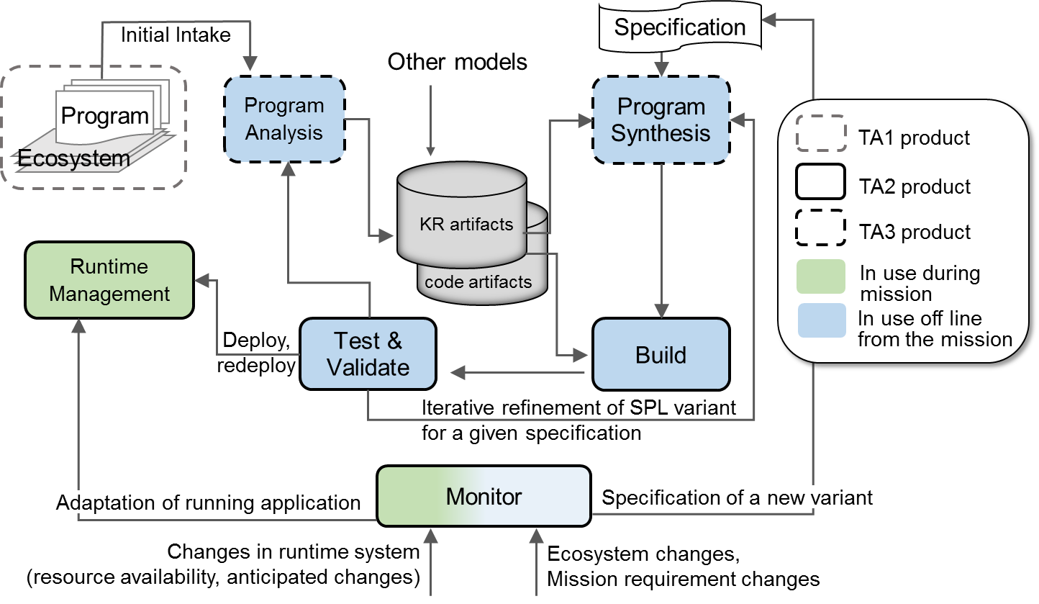
Knowledge Representation
Securboration to develop this section
Cover the following at least:
What purpose does it serve
Introduce the various models
How they are extracted and represented
Ontology
Highlights indicate which parts of the solution is covered/plays a role…

Slide 12
Ontology (Jacob to refine, as needed)
What are we modeling now (basic concepts and relations that must be modeled):
Basics/Core
Application (Product), Component, ProductArchitecture, Classes, Functions
Additional concepts related to Java and Bytecode
SA Domain specifics
Image, Location, LocationProvider, ImageProvider, LocationConsumer, ImageConsumer
Ecosystem
Service, Library, Host, Network, CPU, Memory, GPSSignal
Mission
SADataSize, NumClients, ReportingFreq
Immortals specific
DFU, DFUID, SemanticSpec, ResourceType (consumed as well as provided), ControlPoint
Notes:
This is how we are thinking– the ontology is currently generated bottom up (i.e., do what we need and when we need)

Slide 13
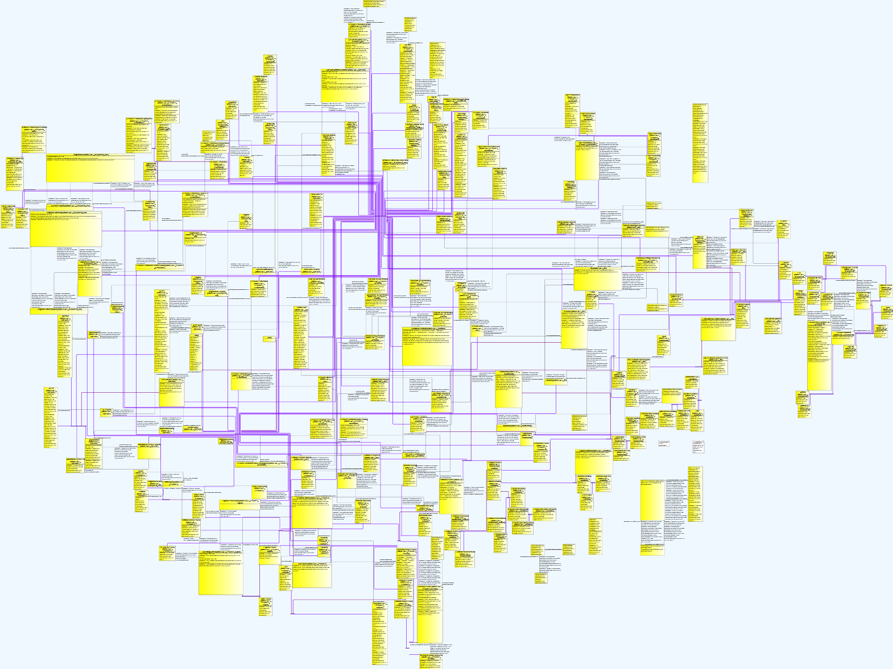
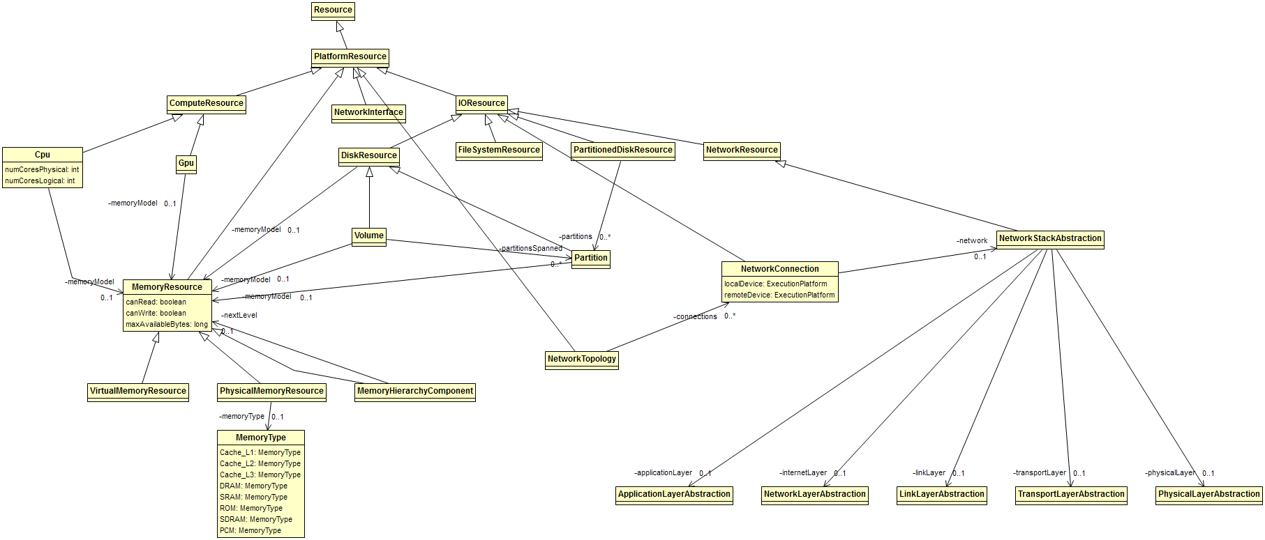
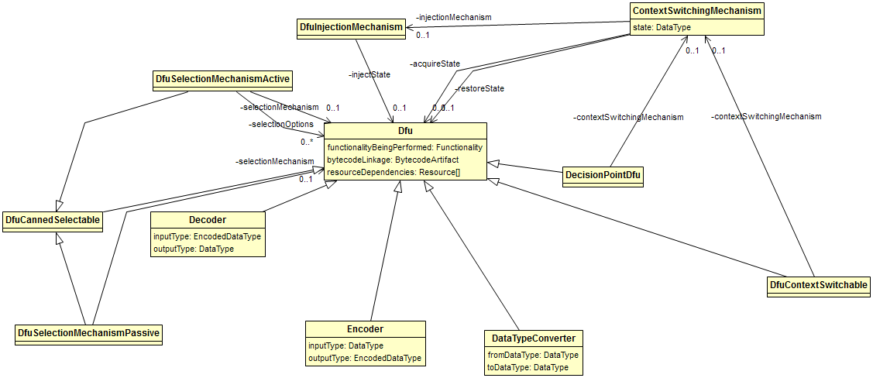
(Jacob to refine, as needed)

Slide 14
Component, DFU, Models – Part 1
(Jacob to refine, as needed)
DFUs are the code units that IMMoRTALS manipulate. The simplest evolution is substitution of PLA components, in which case component == DFU
…
x = new X (…);
x.init(…);
…
y= new Y(…);
y.init(…);
…..
x.setNext(y);
….
No single way to point to a “DFU”
No easy way to represent resource description
Class X {
…
…
}
A
B
X
Class Y {
…
…
}
Y
IMMoRTALS is using
JAVA annotation to define the DFUs (e.g., semantic spec is captured as an annotation)
Triple store to catalog DFUs
Resource DSL to describe resource spec
Triple store to store the relationships (models)
Product (Arch Model)
Codebase
Component
DFU
Notes:
Where we are in terms formalizing the proposed concepts and implementing them

Slide 15
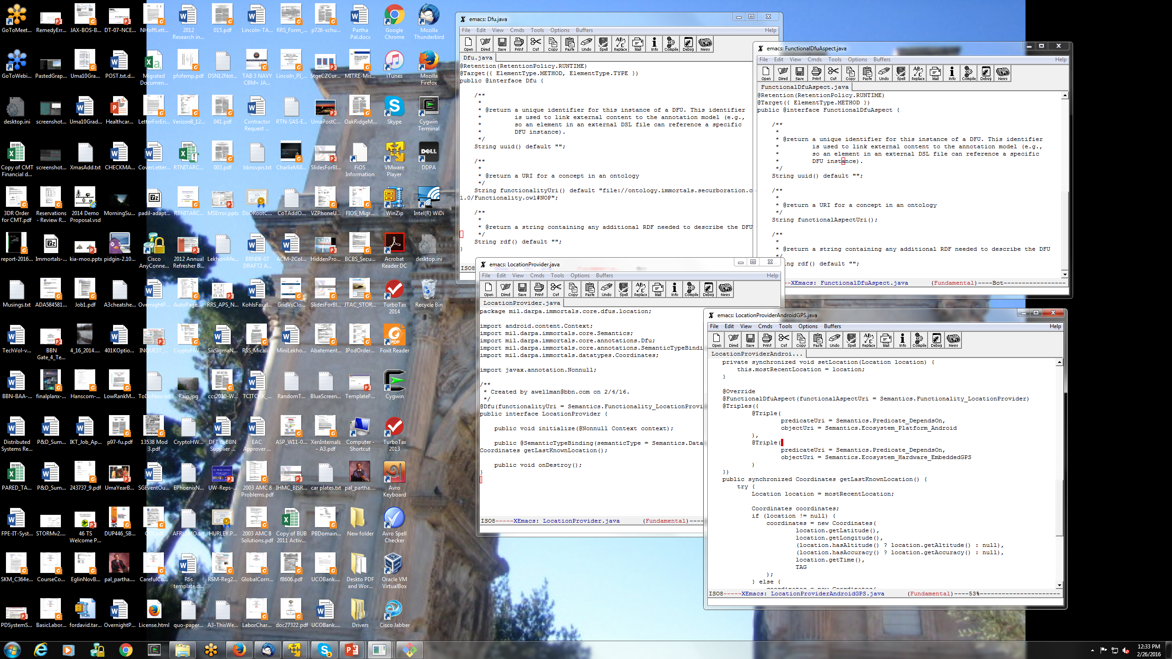
(Jacob to refine, as needed)

Slide 16
Component, DFU, Models – Part 2
(Jacob to refine, as needed)
DFUs that are not PLA components– code units that can be evolved to accommodate ecosystem change, e.g., a function in a class
Library or user defined classes
Class X {
M1 m1;
M2 m2;
…
…
M2 f1(…) { … } ;
void f2(…) {
m2 = f1(…);
};
}
Basic type
m1
m2
Output (M2)
Output (void)
Easier to point to a DFU, but not enough for modifying f1
Need functional (semantics) and extra-functional (resource) spec (obvious)
May need some representation and dependency of f1’s internal and f1’s relationship in its container (e.g., class) as well (can potentially be on-demand)
uses
f1
f2
Inputs
Inputs
Input types (basic, library or user defined
Arch model of class
Code base
Function
Corresponding DFU

Slide 17
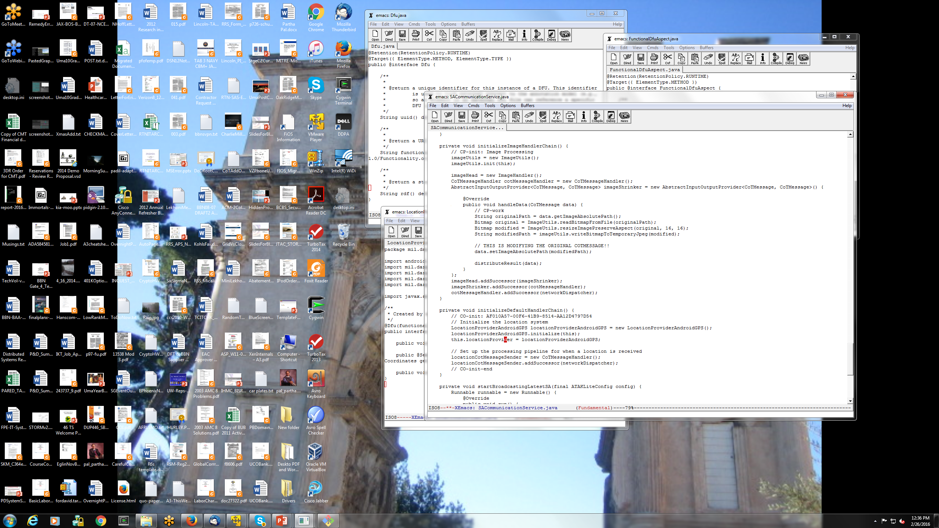
(Jacob to refine, as needed)

Slide 18
Analysis (Heng/Yue to refine as needed)
Syracuse to develop this section
Cover the following at least:
What purpose does it serve
Introduce the various types of analysis
What is the expected output/where they are going/how they will be used
Where are we now
Highlights indicate which parts of the solution is covered/plays a role…

Slide 19
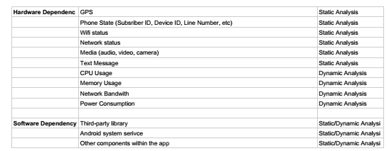
Program Analysis
(Heng to refine, as needed)
Overall goal is to do static and dynamic analysis to
Identify program structure
Dependency among structural elements
Input dependency
Resource dependency
The output is consumed by
Constructing the application model
Creating the resource descriptions for DFUs

Slide 20
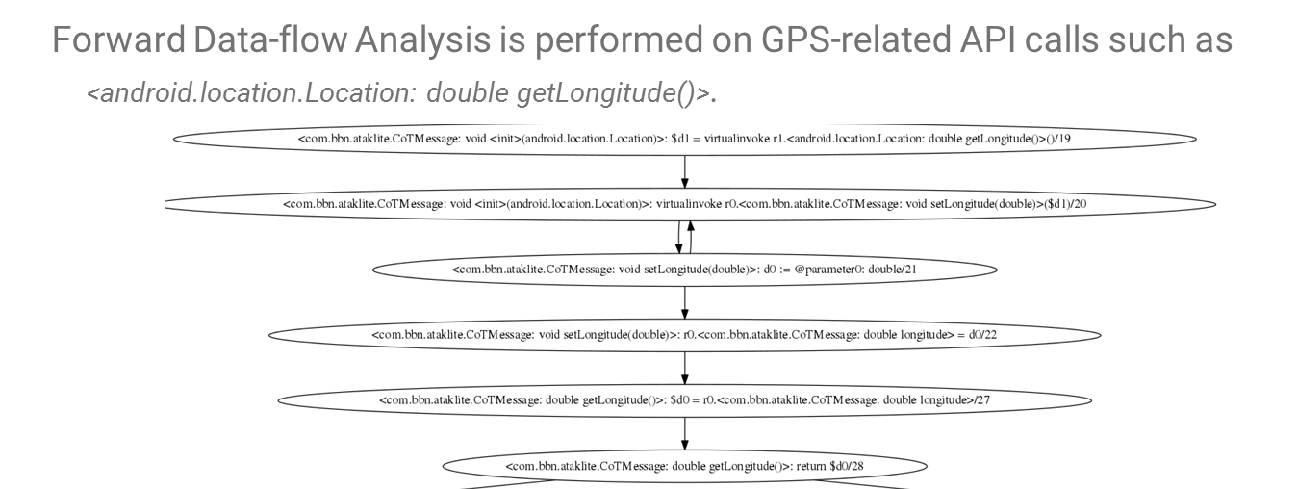
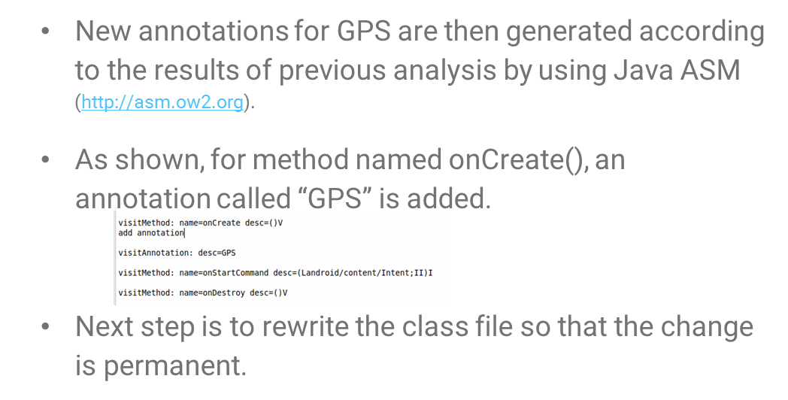
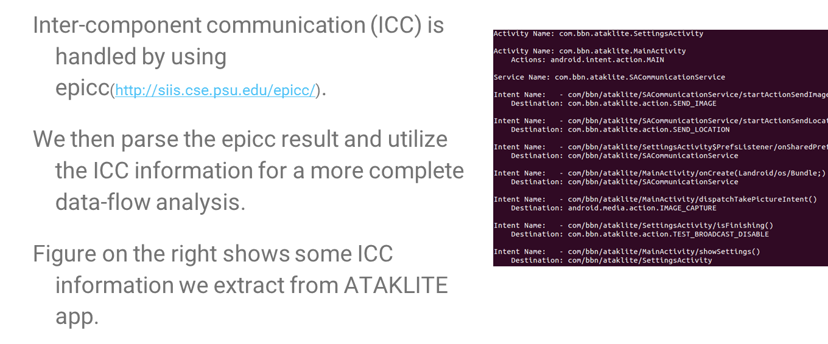
Annotations from Data flow and Inter-Component Communication
(Heng to refine, as needed)
Notes:
Current status

Slide 21
OSU– Alex/Aarash
Anything to add from mutation and schema evolution?

Slide 22
DSL (Eric to Refine)
OSU to develop this section
Cover the following at least:
What purpose does it serve
Different “type theories”, different usages (checking, inference, etc.)
(Answer the questions he might ask)
Where are we now
Highlights indicate which parts of the solution is covered/plays a role…

Slide 23
Resource Specification DSL
Overall goal: language to specify, type system to check fitness of EFS
Conceptual overview
Atomic DFU: a constant with a resource type A B
DFUs can be composed, a component or a product can thus have a resource type
Application model: function that composes DFUs and applies DFUs to resources
Application instance: value produced by application model (after supplying all args)
Deployment model: inputs to application model + expected type of output – inputs: parameters and initial environment – outputs: resulting environment w/ services required by the mission requirements
DFU requires resources/services A, provides B
Can be used to answer these questions:
Does this application instance satisfy the deployment model (type checking)
How do we configure the model to produce a valid instance (type inference)
What is the best configuration for a deployment model (inference + valuation)
Novel combination of three theories:
Linear types: resources are consumable
Refinement types: express constraints on quantities of resources
Variational types: synchronize configuration points across DFUs
Also: use records / row polymorphism for representing and abstracting over resource environments

Slide 24
DSL Example (Part 1)
Sugar for non-linear unit type:
!GPSSatSig => GPSSatSig: !Unit
Needs memory
Dependent variable
Needs GPS sig (non-consumable)
DFU Id
Other resources unaffected (row poly.)
LocationProviderAndroidGPS : { Mem: m@Int, !GPSSatSig | r }
{ Mem: [v | v = m - 128 & v ≥ 0], !GPSSatSig, !LocData | r }
Refined
type
Consumes 128 units of memory to run
Provides location data
Resource type of a DFU (e.g. a substitutable component)
Notes:
These are current thoughts, and may evolve. Shortcomings involve global variables, and what if not all clients get all SA messages (different subscriptions)

Slide 25
DSL Example (Part 2)
A client requires a connection to the hub and consumes uplink and downlink according to the size and frequency of its SA messages, and in the case of downlink also the number of other clients
client: n@Nat → size@Nat → freq@Nat → { !Hub, UL: u@Nat, DL: d@Nat | r } { !Hub, UL: [v | v = u - size*freq], DL: [v | v = d - n*size*freq] | r } Client
A server requires a connection to the hub and consumes uplink and downlink according to number of clients and the size and frequency of its SA messages
server: n@Nat → size@Nat → freq@Nat → { !Hub, UL: u@Nat, DL: d@Nat | r } { !Hub, UL: [v | v = u - n*(n-1)*size*freq], DL: [v | v = d - n*size*freq] | r } Server
Resource type of a larger unit (e.g. a client or server application)
Notes:
These are current thoughts, and may evolve. Shortcomings involve global variables, and what if not all clients get all SA messages (different subscriptions)

Slide 26
DSL Example (Part 3)
A sample deployment model for a network with 10 clients and a server:
– Input parameters: n = 10, size = 20, freq = 1
– Input environment: { !Hub, UL = 5000, DL = 5000 }
– Output type: { !Hub, UL: [v | v ≥ 0], DL: [v | v ≥ 0] } Server Client¹⁰
Application model:
app = λ n size freq env₀ .
let (env₁, s) = server n size freq env₀ in
let clients (env_{i}, cs) =
let (env_{i+1}, c) = client n size freq env_{i} in (env_{i+1}, c :: cs) in
let (env_{n}, cs) = foldr (∘) id (replicate n clients) (env₁, nil)
in (env_{n}, s, cs)
Helper function: generate a client and add it to a list
Generate the server
Generate n clients, accumulating results
Manually thread environment through:
– linear types ensure we get it right (e.g. can’t reuse the same memory for two clients)
– can abstract away with monad pattern
Notes:
Once again– current thoughts

Slide 27
DSL Status
Plan of attack:
Get known technologies working together first (records, linear types, refinements)
Then mix-in variability (past experience: complex, cross-cutting concern)
Already know the theorems we want w/r/t variability: configuration commutes with semantics, type checking, type inference, etc.
Working: semantics (interpreter / big-step), type checking values
Enables checking if a particular configuration satisfies the deployment model
In progress: checking explicitly typed terms
Enables checking if an application model is type-correct
TODO: unification + type inference + variability
Enables efficiently identifying configurations that satisfy deployment model
Biggest research challenge: integrating refinements + variability
Naive integration may not scale if it produces big variational SMT problems
Keys (prev. work): share context (split late), aggressively reduce (join early)
Smaller formulas = more sharing, try to achieve with slicing, refactoring, etc.
Notes:
Once again– current thoughts

Slide 28
Change Requests (Fred to update)
What is it, what purpose
GME model
Other interfaces

Slide 29
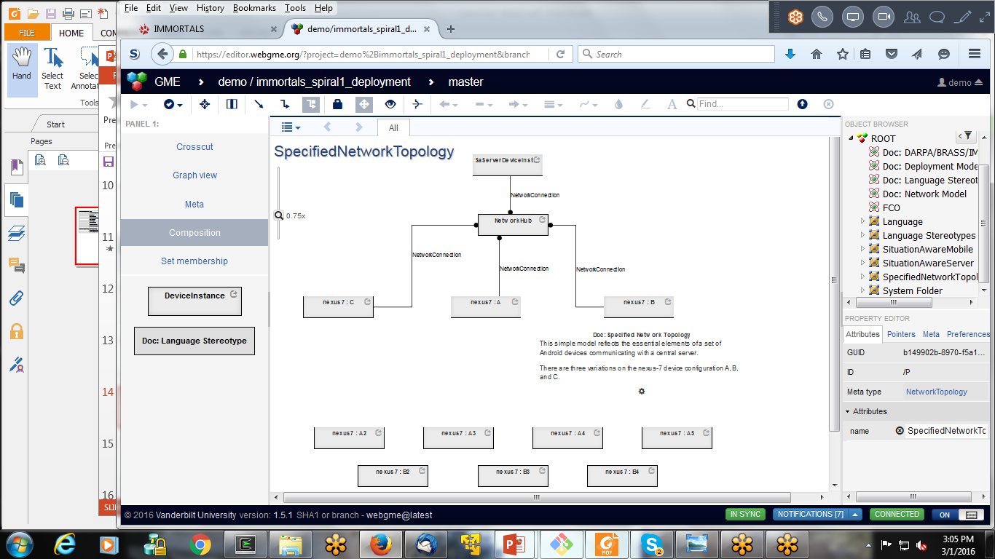
Specifying the Target Environment and Mission Requirement
Notes:
These models are used to test and evaluate and also provides the parameters for our queries (i.e., find a DFU that match)

Slide 30
DAS (Matt to provide)
Workflow
Implementation

Slide 31

Build System (DAS) (1)
Baseline Application Code
DFU implementations (annotations + code artifacts)
…
GPSLoc gps = new GPSLoc(…)
while(true) {
r = gps.getLocation();
sendReport(r);
sleep(x);
}
…
+ GPSLoc & other classes
@func_spec:LocProvider
Class GPSLoc
@init
GPSLoc()
…
@doWork
Location getLocation() {…};
…
@cleanup
@func_spec:LocProvider
Class SAASMLoc
@init
SAASMLoc()
…
@doWork
Location getSAASMLoc() {…};
…
@cleanup
Compilable
Arch Template
(limiting the scope of what can be evolved)
Triple Store
…
//init-CP-1
while(true) {
//doWork-CP-1
sendReport(r);
sleep(x);
}
//cleanup-CP-1
…
Application model
CP:
in Client.java,
template id CP-1
DFU Descriptions
DFU ID 1
Name: SAASMLoc
@f_s: LocProvider
Source: ….java
Dependencies:
DSL File:
DFU ID 2
….
Mission Requirements
Call Freq: 1Hz
Target (deployment)Ecosystem
No GPS Sat, Bandwidth: x
Notes:
Current thought– mission req and target environment description may also be stored in the triple store.

Slide 32
Build System (DAS) (2) Workflow
Given changes in mission/deployment target
Look up from the RDF store to identify the CPs in the product
which parts of the product can we evolve
Look up from the RDF store which DFU can be used to substitute the existing DFU at that CP (if any) based on semantics (functional spec)
Check the inferred Java/Bytecode signatures match (programming language semantics)
Invoke the DSL check to see if the resource descriptions fit (i.e., 1 hz for the SAASMLoc is less than the available bw)
Build the new product, compile, and test

Slide 33
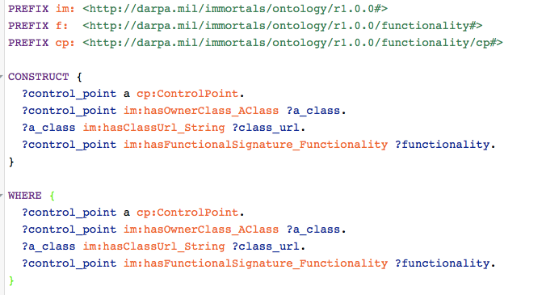
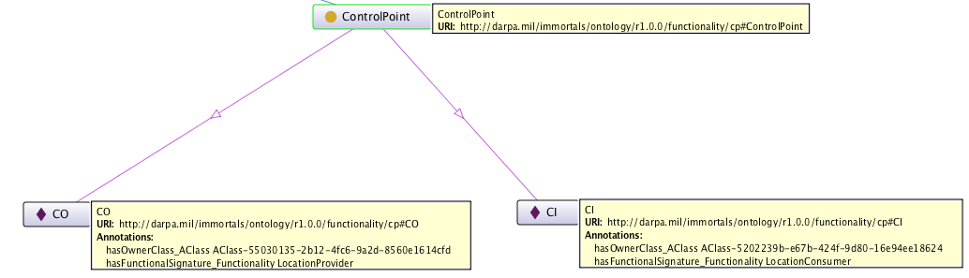
Example Queries (1)
Query the triple store for control points, to retrieve their source files and functionality
Results (shown as an RDF Graph)

Slide 34
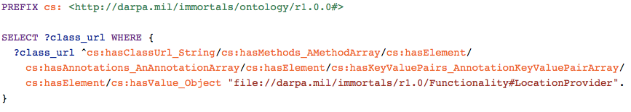
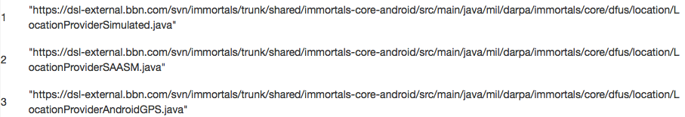
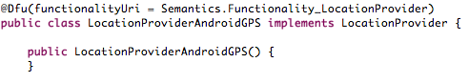
Example Queries (2)
Query the triple store to retrieve the DFUs offering a given functional spec
query
result
The triples/RDF graph that is being queried are created by Bytecode analysis, for example, the annotation below leads to the triple on the right:
LocationProviderAndroidGPS
hasFunctionality
LocationProvider

Slide 35
LL Interactions (Partha to update)
DAS and System Under Test
The IMMoRTALS backend server is the DAS?
The backend server + runtime system (the Marti server and the android clients/emulators) is the DAS?
What is the system under test
When we are dealing with offline adaptation– i.e., responding to new mission requirements
When we are responding to runtime changes
LL Interface and Perturbation Language
LL State machines
start
s2
start
s
s1
s3
s
s1
s2
e
error
Build time
e
Run time
error
s: start eval → s1
s1: new mission req/deployment model C → s2
s1: no matching DFU found → e
s2: new app is built and tested → s3
s2: failed to build and test → e
s: start eval → s1
s1: a client publishes SA update U → s2
s2: all subscribed clients receive U → s1
s2: not all subscribed clients receive U→ e

Slide 36
Summary/Conclusion (Partha to provide)

Slide 37
Backups
2017
2018
2015
2016
2017
01 | 02 | 03 | 04 | 05 | 06 | 07 | 08 | 09 | 10 | 11 | 12 | 13 | 14 | 15 | 16

